Slide 1

Welcome!

Slide 2
Today’s Agenda:
Introduction to Mediflex
Table Mounted Retractor Products
Surgical Holders and Positioners
Laparoscopic Instruments
Laparoscopic Disposables
Throughout these presentations there will be slides requesting you to discuss with the program speaker how the information being presented can be of use to you during your sales calls.

Slide 3
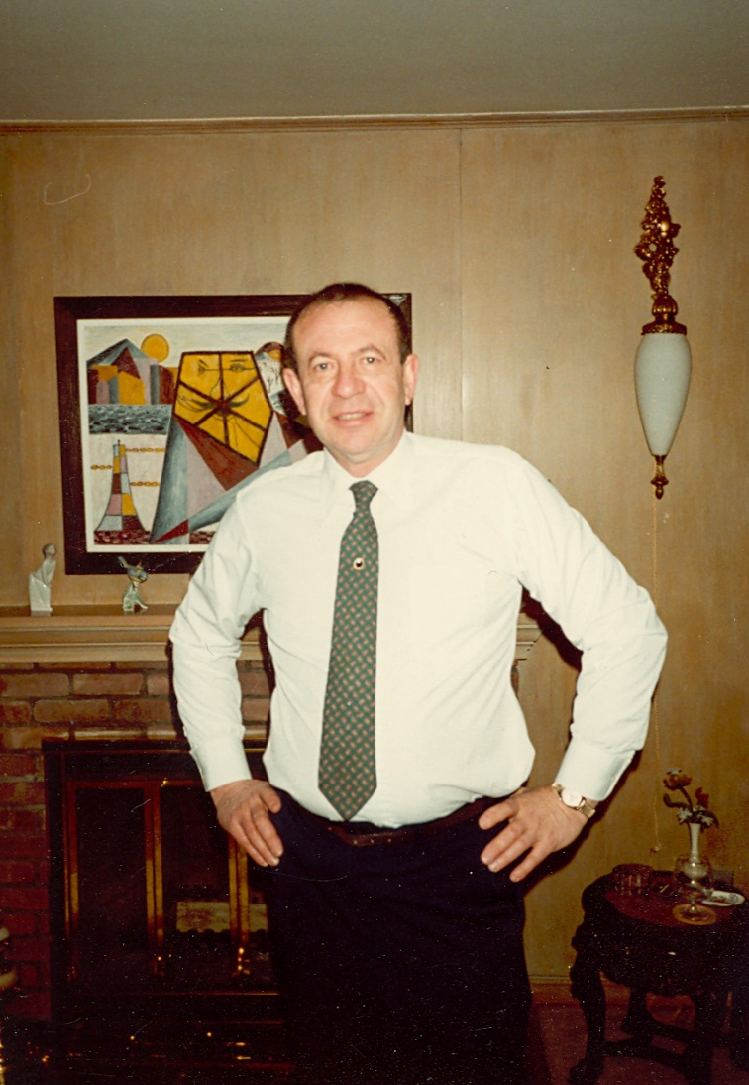
Introduction to Mediflex
1965
  David T. Adler
  Flexbar

Slide 4
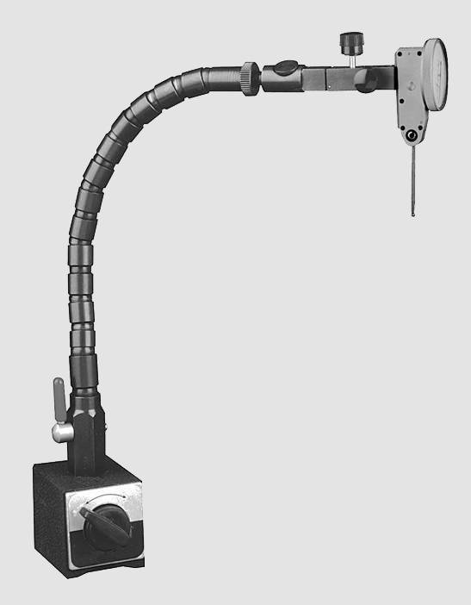
Introduction to Mediflex
Flexbar took its name from its most popular product: A flexible holding device for industrial use.

Slide 5
Introduction to Mediflex
1969
  Flexible Arm used in surgery for the first time in an open heart procedure at the Cleveland Clinic
1970
  David collaborated with Mel
  Greenberg, M.D. a
  Neurosurgeon.

Slide 6
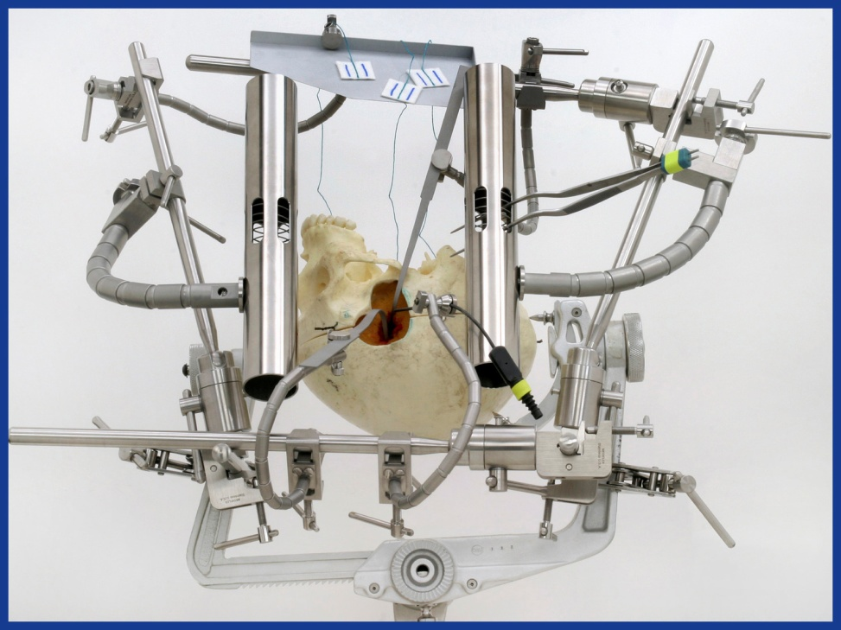
Introduction to Mediflex
The Result was The Greenberg System
Made by Flexbar
Marketed by Codman Division of J&J

Slide 7
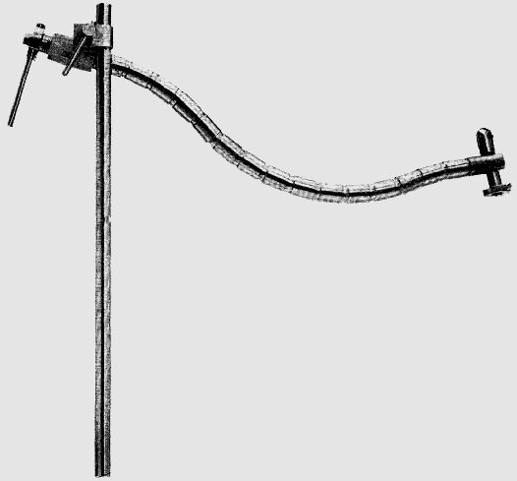
Introduction to Mediflex
1974
  The first Flex Arm™ Laparoscopic Holding and Positioning Device is developed for Gynecologists to hold their Operating Laparoscopes.

Slide 8

Introduction to Mediflex
1982
  Codman asks David Adler to work with John Bookwalter, M.D. in the development of the Bookwalter Table Mounted Retractor System

Slide 9
Introduction to Mediflex
1984
  Codman contracts with Flexbar to manufacture many of the Bookwalter System Components.
  Contract continued for more than 20 years

Slide 10
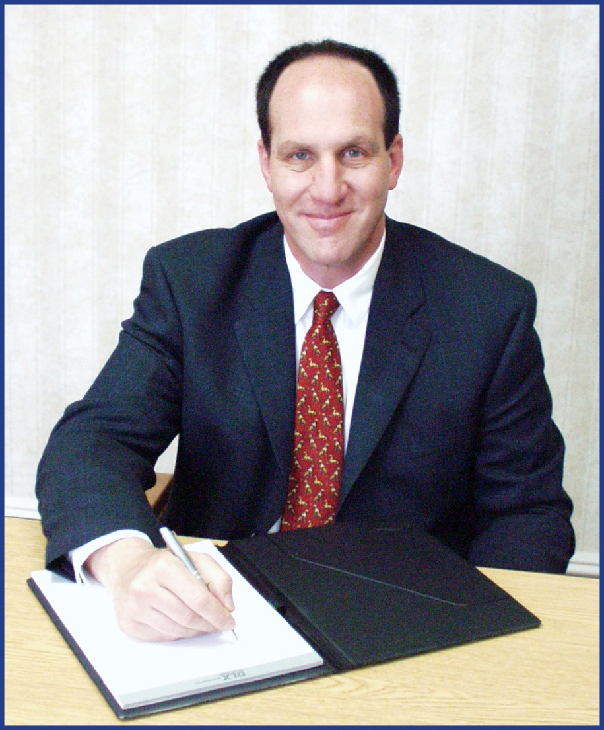
Introduction to Mediflex
1986
  David’s son, Jon Adler, joins Flexbar

Slide 11
Introduction to Mediflex
1989
  Explosive growth of Laparoscopy due to development of videolaparoscopy fuels expansion of Flex Arm Product Line
1992
  The Mediflex Division of Flexbar is created to reflect the growth in medical devices
  Mediflex introduces Laparoscopic Instruments to complement the Flex Arm Product line

Slide 12
Introduction to Mediflex
Mid to late 1990’s
  Other Medical Device Companies turn to Mediflex for OEM Devices
Circa 2000
  Original Bookwalter Patents have expired. Mediflex markets an Identical Table Mounted Retractor System, but puts its Distributors’ name on the product

Slide 13
Introduction to Mediflex
Early 2005
  Codman notifies Flexbar that the Bookwalter contract with Flexbar will be allowed to expire 12-31-2005
  Mediflex decides to Market the Table Mounted Retractor System under the Mediflex brand using our own trademarked name:
  BOOKLER®
  ^{John Bookwalter + David Adler}

Slide 14
Introduction to Mediflex
Q2, 2005
  Mediflex launches Mediflex-Europe based in the UK
  This allows development of a Distributor network throughout the continent
2006
  International growth continues in the Mideast and Eastern Europe

Slide 15
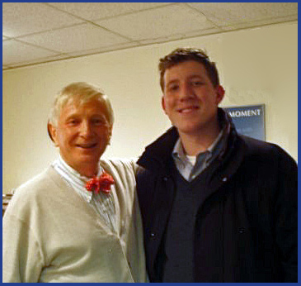
Introduction to Mediflex
June, 2007
  Jon’s son (and David’s grandson), Dan Adler, joins Mediflex. Dan is shown here with Dr. Bookwalter.

Slide 16
Introduction to Mediflex
2007 - 2012
  Mediflex Introduces several new Product Lines:
    Mini-Bookler Table Mounted Retractors
    Universal Round Bar Table Mounted Retractors
    Davida Neurosurgical Systems
    StrongArm Surgical Holders and Positioners
    StrongArm PLUS Surgical Holders and Positioners
    Cutting Edge Reposable Laparoscopic Scissors
  International growth continues in Latin America, Asia and the South Pacific

Slide 17
Introduction to Mediflex
2013
  Over 95% of Mediflex products are made in the US
  Mediflex has direct distributors in over 50 countries and indirect distribution in scores of others
  …and has become one of the most respected small companies in Surgical Instrumentation

Slide 18
Introduction to Mediflex
The Future
  Continue to expand World-Wide Distribution
  Continue to make incremental improvements to existing products
  Continue to expand our product portfolio.

Slide 19
Introduction to Mediflex
Open Discussion:
Do your customers know who Mediflex is?
Probably not.
So, what are some of the key points of this Presentation that can assist you in introducing Mediflex and help you in selling Mediflex products?
(The next slide will review some of the possible responses)

Slide 20
Possible key points
  Mediflex may not be well known to your customers, but they should know that Mediflex…
    …has been making Surgical devices for nearly 50 years
    …is a family company now with a 3rd generation involved
    …created the market segment we refer to as Surgical Holders and Positioners
    …helped in the creation of the Bookwalter Table Mounted Retractor and manufactured much of it for Codman
    …has dozens of other Medical Device Manufacturers (such as J&J) who rely on Mediflex for designing and manufacturing quality surgical products
    …now markets its products in over 50 countries around the world

